Slide 1
CEIS295 Module 6
Speed Test for ArrayList Data Structure
Edward Alvarado 8/15/2021

Slide 2
Rubric
Activity | Requirement(s) | Points
Develop Code to Test Algorithm Speed | BinarySearchTreeActualSpeed.py Code | 20
Screenshot to Demonstrate Working Application | Screenshot of running application showing your name and the current date | 20
Excel Table Showing Relevant Speeds | Table Showing Speeds | 10

Slide 3
BinarySearchTreeActualSpeed.py Python Code
# Name: Edward Alvarado
# Date: 08/15/2021
from BinarySearchTree import BinarySearchTree
from Client import Client
from datetime import date
import time
import sys
import random
# display author's name and the date in the output
print("Name:", "Edward Alvarado")
print("Date:", date.today())
print()
# create a list
clients = []
# read records into the list
input_file_name = "ClientData.csv"
with open(input_file_name) as infile:
for line in infile:
s = line.split(',')
# split the line based on the commas
client_id = int(s[0]) # convert the default string into an int
f_name = s[1]
l_name = s[2]
phone = s[3]
email = s[4]
# create client object using data from the line
clt = Client(client_id, f_name, l_name, phone, email)
# add client object to the list
clients.append(clt)
# how many client objects do we have?
num_records = len(clients)
# create the Binary Search Tree to test real-world speeds
my_bst = BinarySearchTree()
# Scenario 1: Printer Queue or Call Queue or Service Queue
section_title = "Scenario: Printer Queue or Call Queue or Service Queue"
print(section_title)
print("-" * len(section_title))
# how long does it take to add the client records to the BST
start_time = time.time()
for i in range(num_records):
my_bst.insert(clients[i])
end_time = time.time()
total_time = end_time - start_time
print("Seconds to add records: {0:.6f}".format(total_time))
#how long does it take to remove records
start_time = time.time()
for i in range(num_records):
my_bst.remove_minimum()
end_time = time.time()
total_time = end_time - start_time
print("Seconds to remove records: {0:.6f}".format(total_time))
# Scenario 2: Customer Service Center
answer = input("Continue (y/n)? ")
if answer.lower() != "y":
sys.exit() # end the application
section_title = "Scenario: Customer Service Center"
print(section_title)
print("-" * len(section_title))
# add clients to the BinarySearchTree
for i in range(num_records):
my_bst.insert(clients[i])
# how long does it take to randomly display 1000 client records
start_time = time.time()
for i in range(1000):
smallest_id = 100001
largest_id = smallest_id + num_records
random_num = random.randint(smallest_id, largest_id)
print(my_bst.search(Client(random_num)))
end_time = time.time()
total_time = end_time - start_time
print("Seconds to display 1000 random records: {0:.6f}".format(total_time))
# Scenario 3: Call center
answer = input("Continue (y/n)? ")
if answer.lower() != "y":
sys.exit() # end the application
section_title = "Scenario: Call center"
print(section_title)
print("-" * len(section_title))
# add clients to the BinarySearchTree
for i in range(num_records):
my_bst.insert(clients[i])
# how long does it take to add more client records,
# randomly display 1000 records, and randomly remove 1000 records from the bst?
start_time = time.time()
# add records
current_id = 100001 + num_records + 1
for i in range(1000):
my_bst.insert(Client(current_id))
current_id += 1
# display records
for i in range(1000):
smallest_id = 100001
largest_id = smallest_id + num_records
random_num = random.randint(smallest_id, largest_id)
my_bst.search(Client(random_num))
# remove 1000 random records
for i in range(1000):
smallest_id = 100001
largest_id = smallest_id + num_records
random_num = random.randint(smallest_id, largest_id)
print(my_bst.remove(Client(random_num)))
end_time = time.time()
total_time = end_time - start_time
print("Seconds to add records, ")
print(" display 1000 random records, ")
print(" and remove 1000 random records: {0:.6f}".format(total_time))
Paste your Python code. Include the following processes:
Read records into application
Test the following process speeds:
Add records to beginning of data structure
Add records to end of data structure
Add records to middle of data structure
Retrieve records from beginning of data structure
Retrieve records from end of data structure
Retrieve records from middle of data structure

Slide 4
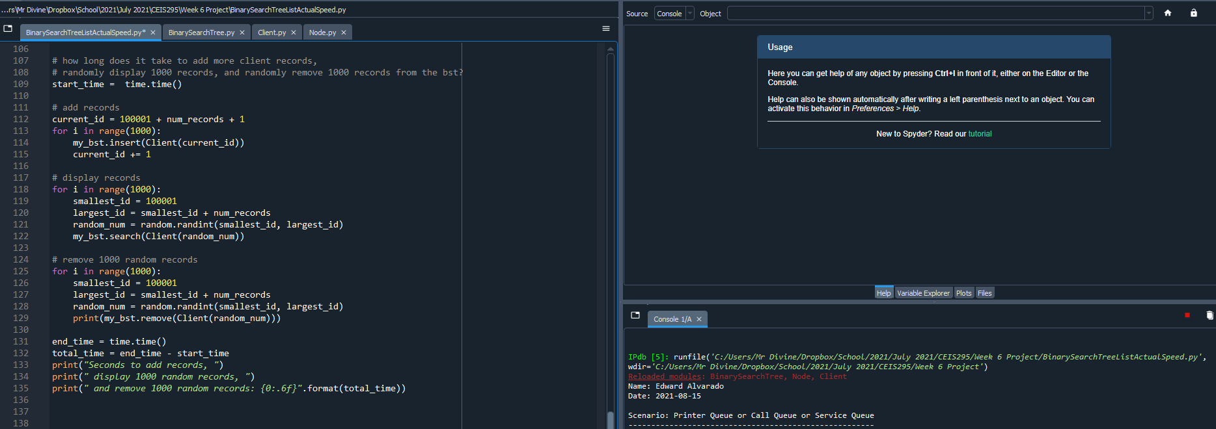
Screenshot of Running Code
Run your BinarySearchTreeActualSpeed.py code and take a screenshot of the output. The output screenshot must show your name and the date to be accepted.
Please note. We are looking to avoid plagiarism. As a result, if the running code does not show your name and the current date, then this Course Project will be given a zero until you submit a PowerPoint that shows your name and the current date in the output screenshot.

Slide 5
Table of Speeds
Update the table from last week that shows the times for the ArrayList and LinkedList. Add a new column and show the times for the BinarySearchTree for comparison.
Printer Queue or Call Queue or Service Queue
Add many records to end of data structure
Pull all records off front of data structure
Customer Service Center
Display random records
Call Center
Add some records
Display random records
Remove some records
Table of Real-World Speeds
 | ArrayList (unsorted) | ArrayList (sorted data) | LinkedList | BinarySearchTree
Scenario: Printer Queue or Call Queue
Add many records to end of data structure: | 0.003003 | 0.0032101 | 0.006006 | 0.017927
Pull all records off front of data structure | 3.386094 | 3.924012 | 0.004004 | 0.021796
Scenario: Customer Service Center
Display random records | 0.41938 | 0.031843 | 0.575524 | 0.082711
Scenario: Call Center
Add some records, display random records, remove random records | 0.922482 | 0.419426 | 1.224979 | 0.327910

